Slide 1




DEPARTMENT OF COMPUTER SCIENCE
AND ENGINEERING
NAME OF THE SUBJECT : Advanced Computer Networks
NAME OF THE TOPIC : Unit 1 – IPv 6
PRESENTED BY :
Mr M Ch J Sekhar
Assistant Professor

Slide 2
Objectives
IPv6 vs IPv4
IPv6 Packet Format
IPv6 fields
IPv6 and data-link technologies

Slide 3
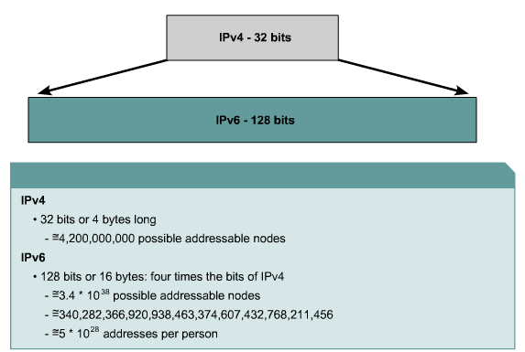
IPv6: Large Address Space
IPV6 header size: 256 bits
IPV4 Header Size: 64 bits

Slide 4
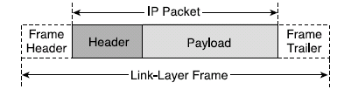
IP Frame
IP packets are carried over link-layer technologies such as Ethernet (10 Mbps), Fast Ethernet (100 Mbps), Gigabit Ethernet (1000 Mbps), Frame Relay, and many others.
Each link-layer technology family has its own link-layer frame that carries IP packets.
IP packet is carried between the frame header and frame trailer of a link-layer frame.

Slide 5
IP Packet
An IP packet has two fundamental components:
  IP header
    IP header contains many fields that are used by routers to forward the packet from network to network to a final destination.
    Contains layer 3 info
    Fields within the IP header identify the sender, receiver, and transport protocol and define many other Parameters.
  Payload
    Represents the information (data) to be delivered to the receiver by the sender.
    Contains data & upper-layer info

Slide 6
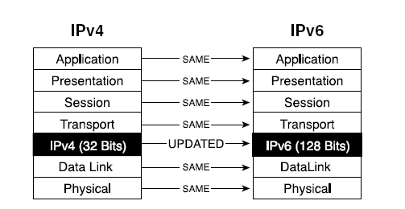
Scope of IPv6 with the OSI Reference Model

Slide 7
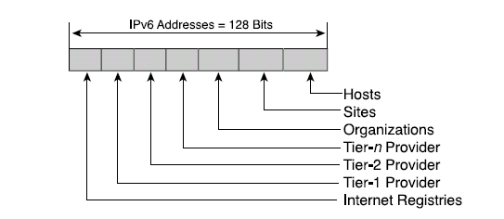
Levels of Addressing Hierarchy

Slide 8
IPv4 Addressing Concepts and Their IPv6 Equivalents
IPv4 Address | IPv6 Address
Address Length – 32 bits | 128 bits
Address Representation - decimal | hexadecimal
Internet address classes | Not applicable in IPv6
Multicast addresses (224.0.0.0/4) | IPv6 multicast addresses (FF00::/8)
Broadcast addresses | Not applicable in IPv6
Unspecified address is 0.0.0.0 | Unspecified address is ::
Loopback address is 127.0.0.1 | Loopback address is ::1
Public IP addresses | Global unicast addresses
Private IP addresses (10.0.0.0/8, 172.16.0.0/12, and 192.168.0.0/16) | Site-local addresses (FEC0::/10)
Autoconfigured addresses (169.254.0.0/16) | Link-local addresses (FE80::/64)

Slide 9
IPv4 Addressing Concepts and Their IPv6 Equivalents
IPv4 Address | IPv6 Address
Text representation: Dotted decimal notation | Text representation: Colon hexadecimal format with suppression of leading zeros and zero compression. IPv4-compatible addresses are expressed in dotted decimal notation.
Network bits representation: Subnet mask in dotted decimal notation or prefix length | Network bits representation: Prefix length notation only
DNS name resolution: IPv4 host address (A) resource record | DNS name resolution: IPv6 host address (AAAA) resource record
DNS reverse resolution: IN-ADDR.ARPA domain | DNS reverse resolution: IP6.ARPA domain

Slide 10
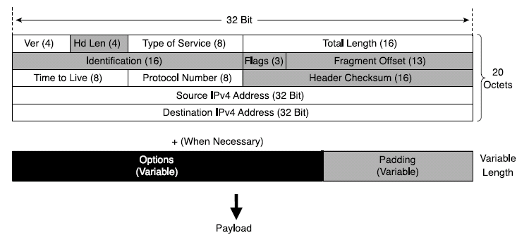
IPv4 Header Structure
basic IPv4 header contains 12 fields.
each field of the IPv4 header has a specific use.
Shaded field are removed in IPv6.
Notes:
Version (4 bits)--Represents the version of the IP protocol. In this case, the field is set to 4.
Header Length (4 bits)--The length in octets of the packet header.
Type of Service (ToS) (8 bits)--This field carries information that enables routers to classify and forward packet in a differentiated manner. It is an important service identifier used in implementing quality of service (QoS).
Total Length (16 bits)The length in octets of the entire packet, header plus payload. With 16 bits available in this field, the maximum length of an IPv4 packet is 65,535 octets.
Identification (16 bits), Flags (3 bits), Fragment Offset (13 bits)--These three fields enable IPv4 networks to support packet fragmentation to negotiate forwarding over links supporting various maximum transmission units (MTUs). Fragmentation is done as needed by the routers along the path of the packet.
Time To Live (8 bits)--It is important to protect a network's resources from packets that loop due to routing problems. This field is used to count down the number of routers that switched the packet. The packet is discarded when the value of this field is 0.
Protocol Number (8 bits)--The Protocol Number lists the upper- layer protocol (TCP, UDP, ICMP, and so on) that is present in the packet payload. The numbers that represent these protocols are assigned by IANA (http://www.iana.org/assignments/protocol- numbers).
Header Checksum (16 bits)--The integrity of the packet header is verified by comparing the computed checksum with the value listed in this field.
Source IPv4 Address (32 bits)--The IPv4 address of the node that sourced the packet.
Destination IPv4 Address (32 bits)--The IPv4 address of the packet destination node.
Options (variable length)--This field is meant as a placeholder for the information relevant to proper handling of the data carried by the packet, information that is not represented in the other fields of the header. Because of this field, the IPv4 header has a variable length, justifying the need for the Header Length field.
Padding (variable length)--Is used to align the variable-length Options field to the 32-bit boundary.

Slide 11
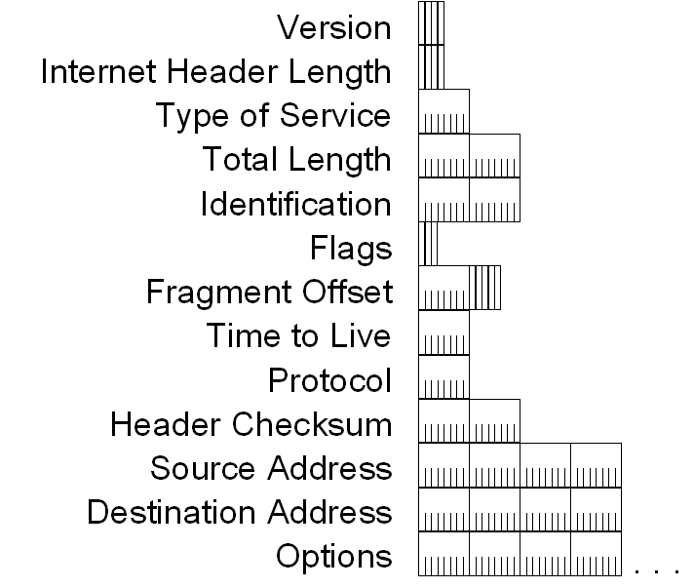
IPv4 Header - Review

Slide 12
IPv4 Header - Review
Version (4 bits)
  Indicates the version of IP and is set to 4.
Internet Header Length (4 bits)
  Indicates the number of 4-byte blocks in the IPv4 header.
  Because an IPv4 header is a minimum of 20 bytes in size, the smallest value of the Internet Header Length (IHL) field is 5.
Type of Service (4 bits)
  Indicates the desired service expected by this packet for delivery through routers across the IPv4 internetwork.
  Contains a 6-bit Differentiated Services Code Point (DSCP) field (RFC 2472) and two flags to support Explicit Congestion Notification (RFC 3168).

Slide 13
IPv4 Header - Review
Total Length (16 bits)
  Indicates the total length of the IPv4 packet (IPv4 header + IPv4 payload) and does not include link layer framing.
  indicate an IPv4 packet that is up to 65,535 bytes long.
Identification (16 bits)
  Identifies this specific IPv4 packet.
  The Identification field is selected by the originating source of the IPv4 packet. If the IPv4 packet is fragmented, all of the fragments retain the Identification field value so that the destination node can group the fragments for reassembly.
Flags (3 bits)
  Identifies flags for the fragmentation process.
  There are two flags—one to indicate whether the IPv4 packet might be fragmented and another to indicate whether more fragments follow the current fragment.
Fragment Offset (13 bits)
  Indicates the position of the fragment relative to the original IPv4 payload.

Slide 14
IPv4 Header - Review
Time to Live ( 8 bits)
  Indicate the maximum number of links on which an IPv4 packet can travel before being discarded.
  Originally used as a time count with which an IPv4 router determined the length of time required (in seconds) to forward the IPv4 packet, decrementing the TTL accordingly. Modern routers almost always forward an IPv4 packet in less than a second and are required by RFC 791 to decrement the TTL by at least one. Therefore, the TTL becomes a maximum link count with the value set by the sending node. When the TTL equals 0,an ICMP Time Expired-TTL Expired in Transit message is sent to the source IPv4 address and the packet is discarded.
Protocol (8 bits)
  Identifies the upper layer protocol.
  For example, TCP uses a Protocol of 6, UDP uses a Protocol of 17, and ICMP uses a Protocol of 1.
  The Protocol field is used to demultiplex an IPv4 packet to the upper layer protocol.

Slide 15
IPv4 Header - Review
Header Checksum (16 Bits)
  Provides a checksum on the IPv4 header only.
  The IPv4 payload is not included in the checksum calculation as the IPv4 payload and usually contains its own checksum. Each IPv4 node that receives IPv4 packets verifies the IPv4 header checksum and silently discards the IPv4 packet if checksum verification fails. When a router forwards an IPv4 packet, it must decrement the TTL. Therefore, the Header Checksum is recomputed at each hop between source and destination.
Source Address ( 32 bits)
  Stores the IPv4 address of the originating host.
Destination Address (32 bits)
  Stores the IPv4 address of the destination host.
Options (multiple of 32 bits)
  Stores one or more IPv4 options.
  If the IPv4 option or options do not use all 32 bits, padding options must be added so that the IPv4 header is an integral number of 4-byte blocks that can be indicated by the Internet Header Length field.

Slide 16
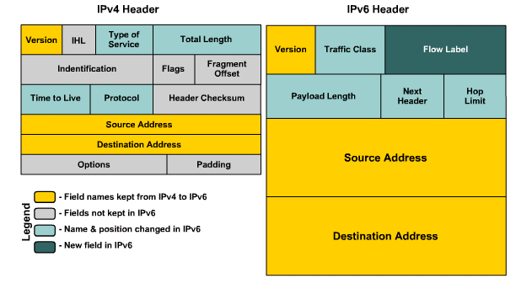
IPv4 vs IPv6 Header

Slide 17
IPv6 Header Format Simplification
Fixed Length for the basic header
  IPv4 header of variable length = min^{m} 20 bytes
  IPv6 = main header length fixed at 40 bytes
    Leads to fast header processing
    No need of Header Length (Hd Len) field in IPv4 – obsolete
Fragmentation only by traffic source
  Source does Path MTU (PMTU) discovery.
  Freeing routers from having to fragment them
  No need of IPv4 Identification, Flag, Fragment Offset
Note: The PTMU Discovery can be processing intensive. It is important to remember, however, that in IPv6 the MTU on any link > 1280 bytes, as specified in RFC 2460.
Notes:
The Options field leads to an IPv4 header of variable length (minimum 20 bytes). By contrast, IPv6 has the main header length fixed at 40 bytes, a benefit to fast header processing because routers do not have to implement lookup processes that account for variable-length headers. The fixed length makes the Header Length field obsolete. The functionality provided by the options is delivered through extension headers, a concept described later in the section. The options and padding are also removed from the main packet header.
Fragmentation is done only by the traffic source--Before sending IPv6 traffic, the source does Path MTU (PMTU) Discovery. It then sends packets at the discovered PMTU, thus freeing the routers from having to fragment them. For this reason, the three IPv4 header fields related to fragmentation (Identification, Flags, and Fragment Offset) become irrelevant in IPv6.

Slide 18
IPv6 Header Format Simplification
Header checksums are eliminated
  IP header checksum recalculated by every node switching the packet due to changing TTL values, thus taxing router resources.
  Improvements on L2 technologies and their 32-bit CRC support since the introduction of IPv4 combined with layer 4 checksums provides sufficient protection to make the layer 3 header checksum unnecessary.
  Packet Header Checksum was eliminated in IPv6 and is in turn enforced at upper layers.

Slide 19
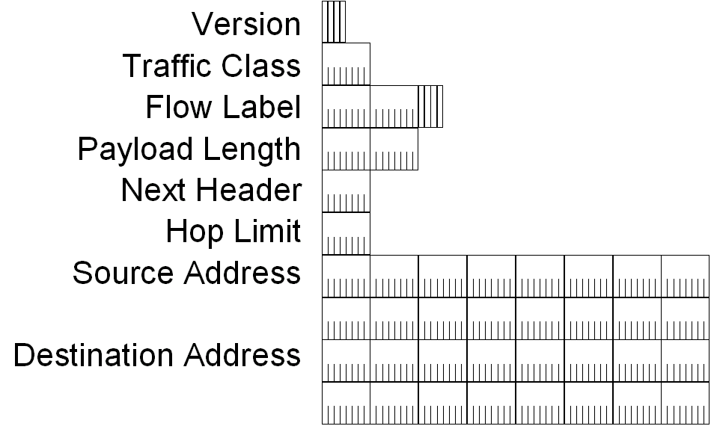
IPv6 Header

Slide 20
IPv6 Header Fields
Based on these rules, RFC 2460 defines the following IPv6 header fields:
  Version (4 bits)
    4 bits are used to indicate the version of IP and is set to 6
  Traffic Class (8 bits)
    same function as the Type of Service field in the IPv4 header.
  Flow Label (20 bits)
    identifies a flow and it is intended to enable the router to identify packets that should be treated in a similar way without the need for deep lookups within those packets.
    set by the source and should not be changed by routers along the path to destination.
    unique & powerful tool to IPv6
    Can be used with differentiated services (DiffServ) as well as integrated services (IntServ) and Resource ReSerVation Protocol (RSVP2).

Slide 21
IPv6 Header Fields
Payload Length (16 bits)
  With the header length fixed at 40 bytes, it is enough to indicate the length of the payload to determine the length of the entire packet.
Next Header (8 bits)
  Indicates either the first extension header (if present) or the protocol in the upper layer PDU (such as TCP, UDP, or ICMPv6).
  When indicating an upper layer protocol above the Internet layer, the same values used in the IPv4 Protocol field are used here.
Hop Limit (8 bits)
  In IPv6, the IPv4 TTL was appropriately renamed Hop Limit because it is a variable that is decremented at each hop, and it does not have a temporal dimension.

Slide 22
IPv6 Header Fields
Source IPv6 Address (128 bits)
  Stores the IPv6 address of the originating host.
Destination IPv6 Address (128 bits)
  Stores the IPv6 address of the current destination host.

Slide 23
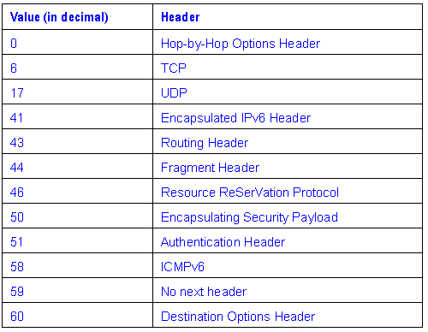
Values of the Next Header Field

Slide 24
IPv6 Next Header (Extension)
The IPv4 header includes all options.
Each intermediate router must check for their existence and process them when present → cause performance degradation in the forwarding of IPv4 packets.
With IPv6, delivery and forwarding options are moved to extension headers.
The only extension header that must be processed at each intermediate router is the Hop-by-Hop Options extension header.
This increases IPv6 header processing speed and improves forwarding process performance.
In a typical IPv6 packet, no extension headers are present.

Slide 25
IPv6 Next Header (Extension)
RFC 2460 defines the following IPv6 extension headers that must be supported by all IPv6 nodes:
  Hop-by-Hop Options header
  Destination Options header
  Routing header
  Fragment header
  Authentication header
  Encapsulating Security Payload header

Slide 26
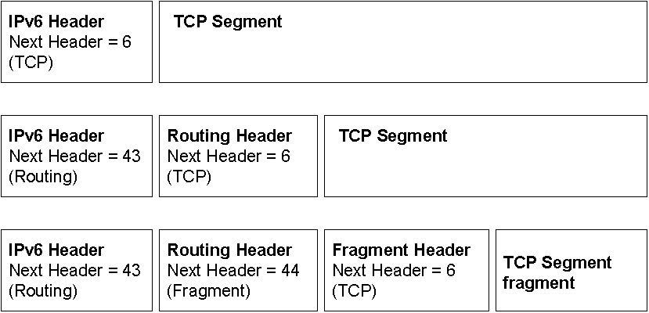
IPv6 Next Header (Extension)
If special handling is required by either the intermediate routers or the destination, one or more extension headers are added by the sending host.
Each extension header must fall on a 64-bit (8-byte) boundary.
Extension headers of variable size contain a Header Extension Length field and must use padding as needed to ensure that their size is a multiple of 8 bytes.
Next Header field in the IPv6 header and zero or more extension headers that form a chain of pointers. Each pointer indicates the type of header that comes after the immediate header until the upper layer protocol is ultimately identified.

Slide 27
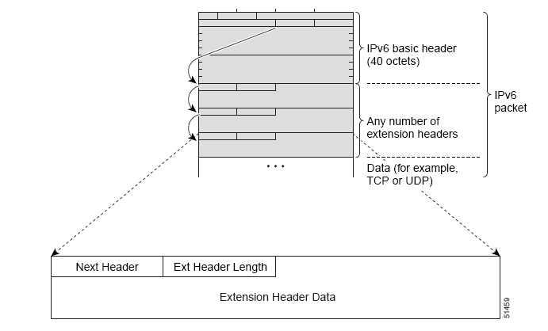
IPv6 Next Header (Extension)

Slide 28
Order is important (RFC 2460)
Extension headers are processed in the order in which they are present.
Because the only extension header that is processed by every node on the path is the Hop-by-Hop Options header, it must be first.
There are similar rules for other extension headers.
In RFC 2460, it is recommended that extension headers be placed in the IPv6 header in the following order:
  Hop-by-Hop Options header
  Destination Options header (for intermediate destinations when the Routing header is present)
  Routing header
  Fragment header
  Authentication header
  Encapsulating Security Payload header
  Destination Options header (for the final destination)

Slide 29
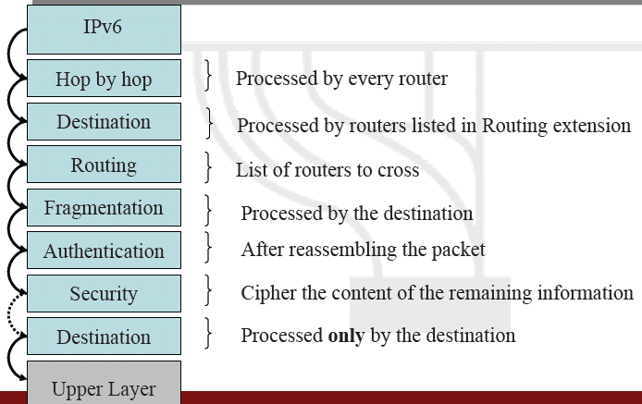
Order is important (RFC 2460)

Slide 30
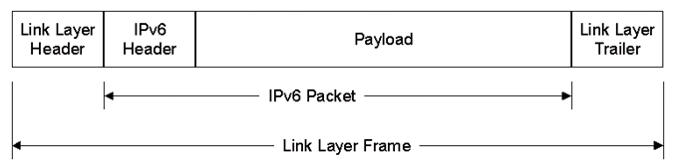
IPv6 Packets over LAN Media
A link layer frame containing an IPv6 packet consists of the following structure:
  Link Layer Header and Trailer
    The encapsulation placed on the IPv6 packet at the link layer.
  IPv6 Header
    The new IPv6 header.
  Payload

Slide 31

IPv6 Packets over LAN Media
For typical LAN technologies such as IEEE 802.3 (Ethernet), IEEE 802.5 (Token Ring), and Fiber Distributed Data Interface (FDDI), IPv6 packets are encapsulated in one of two ways
  Ethernet II header
  Sub-Network Access Protocol (SNAP) header
    EtherType field is set to 0x86DD to indicate IPv6.

Slide 32


